Slide 1
Connect Four Game
Presented by Hafsah, Gen, Yao, Ilija and Calvin

Slide 2
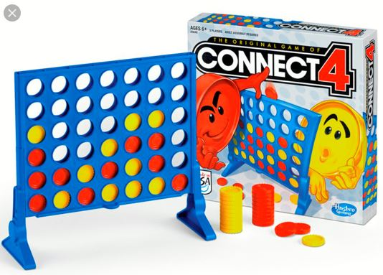
Table of Contents
Our Incentive (Introduction)
Code Design Process
Class Relationships
Milestones
Communication
Installation
Gameplay
Conclusion

Slide 3
Our Incentive
We set out to achieve a new goal: creating an actual connect four game.

Slide 4
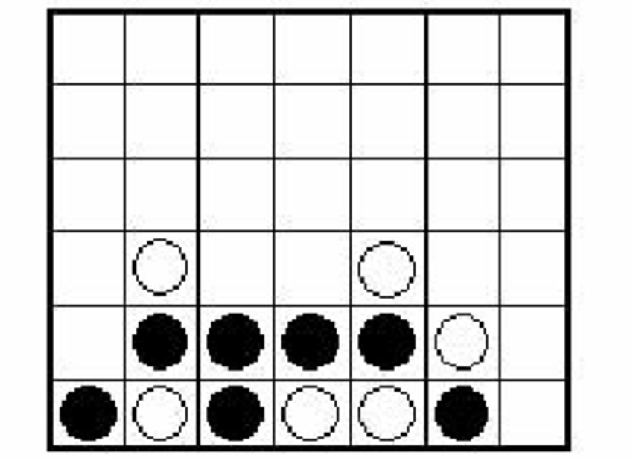
We all know the rules, but how do we arrange the visuals and design the code?
We pick up on all the little details that matter to deliver this experience.
GUI
Picking column
BACKEND
Inform player:
Who’s Turn: ___
score: ___
score: ___
Who won: ___
No floating
Check direction for win

Slide 5

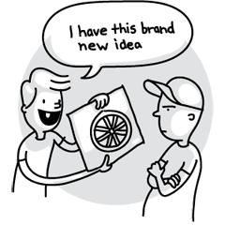
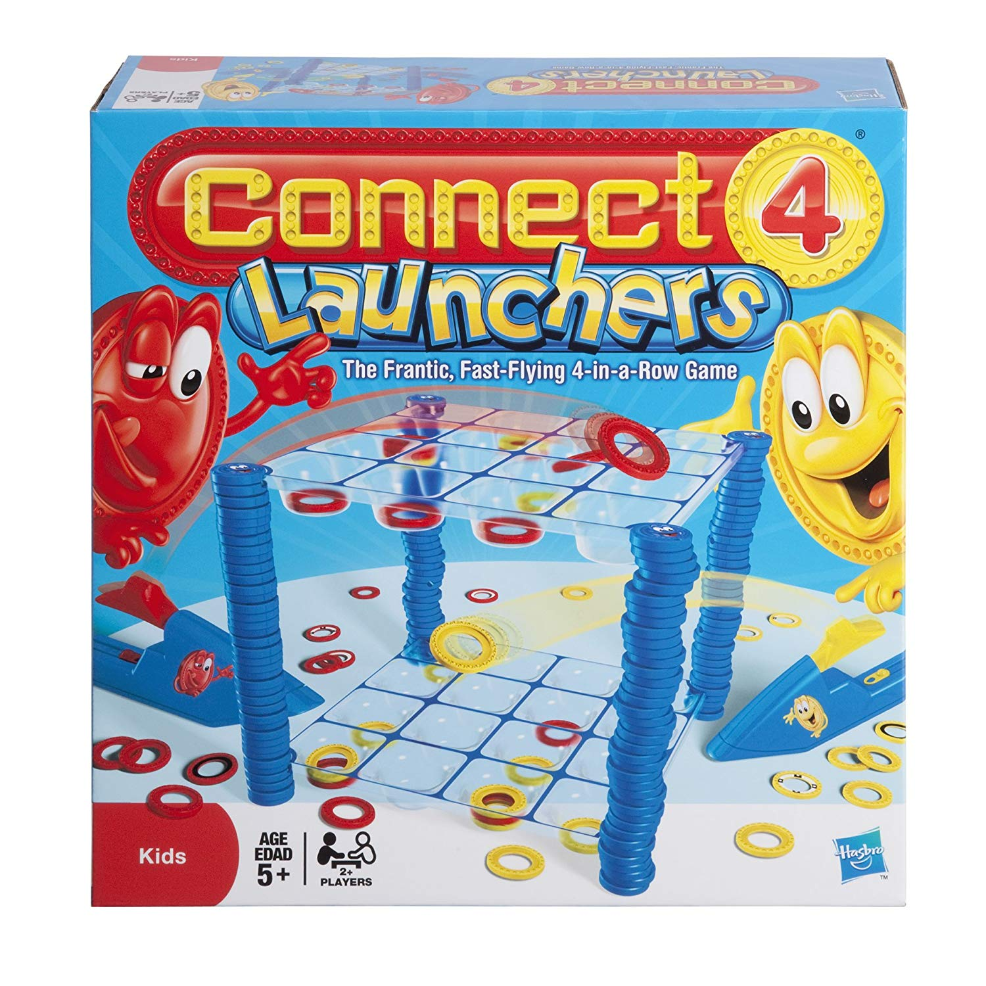
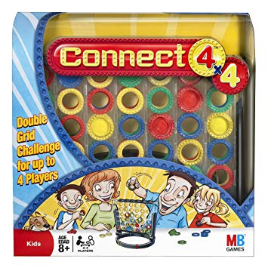
There have been many interpretations of Connect Four. We made our game to be simplest version to keep within scope. So, its not going to be anything new.

Slide 6

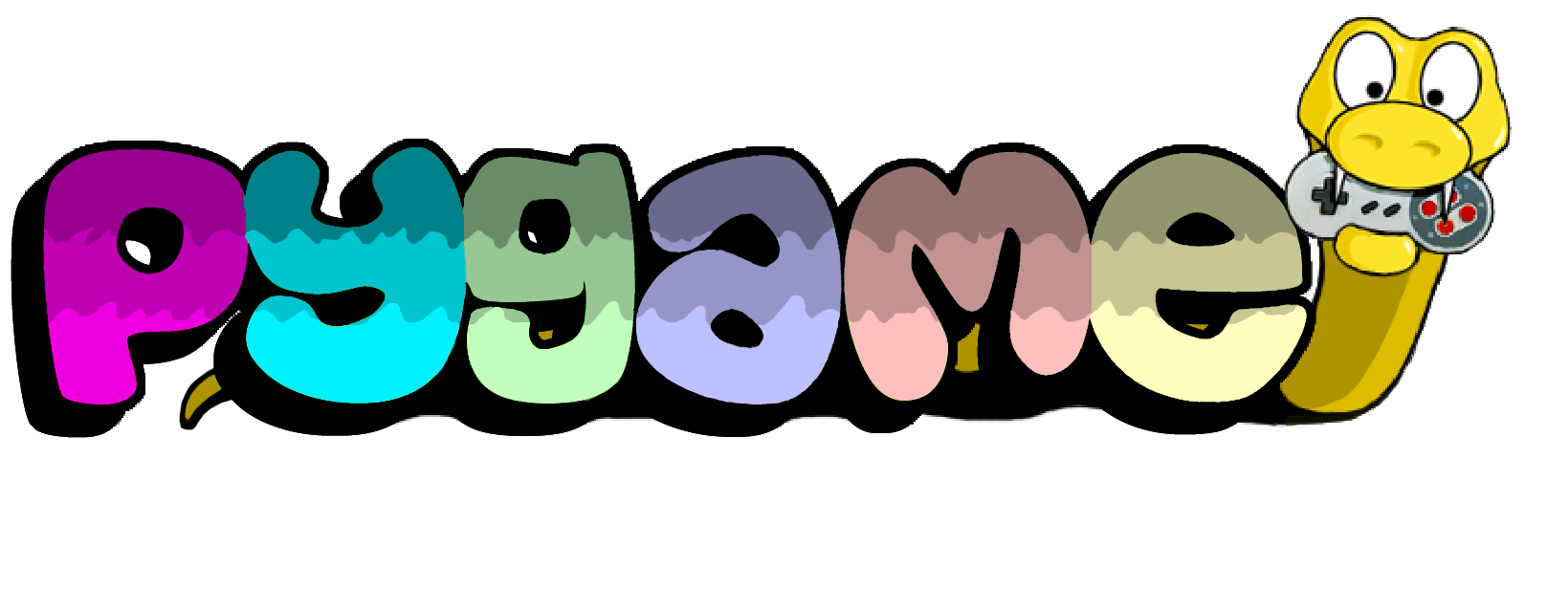

It was a new challenge that we had to overcome, starting with our basic knowledge of python and the game rules.

Slide 7
Code Design Process
Our code design has had a massive overhaul compared to the code design in our previous presentation.

Slide 8
We had learned to adapt the “Agile” methodology of coding for our project.
We had been able to progressively adapt slight changes to our class designs and relationships.
This allowed for us to revisit and improve our implementations.

Slide 9
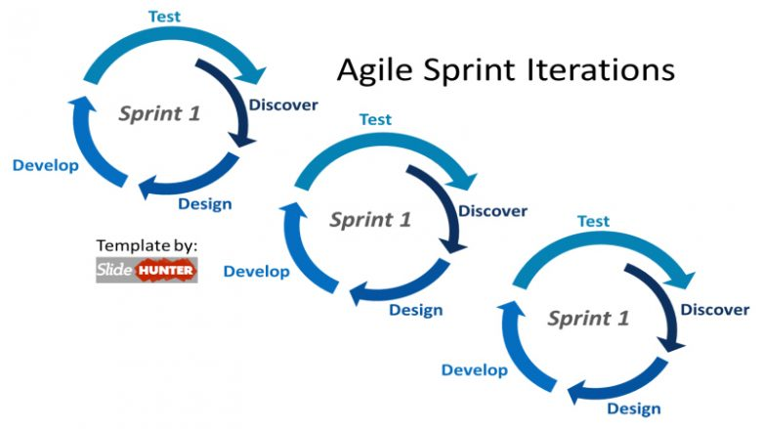

Slide 10
Ex.
<<class>>
ConnectFourBoard
string: P1
string: P2
String: EMPTY
Int: dim_col
Int: dim_row
String: turn
List[List[string]]: board
<<class>>
ConnectFourBoard
string: P1
string: P2
String: EMPTY
Int: dim_col
Int: dim_row
List[List[string]]: board
+ drop(int col): bool
+ other_player(): str
+ whos_turn(): str
+ switch_turn(): None
+ check_for_win(): bool
+ check_win_at_position(row: int, col: int): bool
+ alternation(x: int, y: int, dx: int, dy: int): bool
+ valid_move(col: int, row: int): bool
+ is_game_over(): bool
+ get_drop_loc(col: int): int
+ move_left(): None
+ move_right(): None
+ drop(): None
+ whos_turn(): str
+ check_for_win(): bool
+ valid_move(): bool

Slide 11
Class Relationships
Notes:
2 seconds

Slide 12
Class Relationships Before
Classes:
ConnectFourGUI
ConnectFourBoard
Player
Main
Issues:
Poor Encapsulation
Classes were too interconnected - had difficulty working on one class at a time
Poor Code Readability
Did not make use of design patterns
Notes:
15 seconds

Slide 13
Class Relationships Now
Screen:
Composite Object containing models
- ConnectFourBoard
- Disk
- Button
- TextBox
ConnectFourGUI:
View Class in charge of what the user sees
Instantiates one Screen object
Main:
Controller class in charge of user interaction
Classes:
Notes:
20 seconds

Slide 14
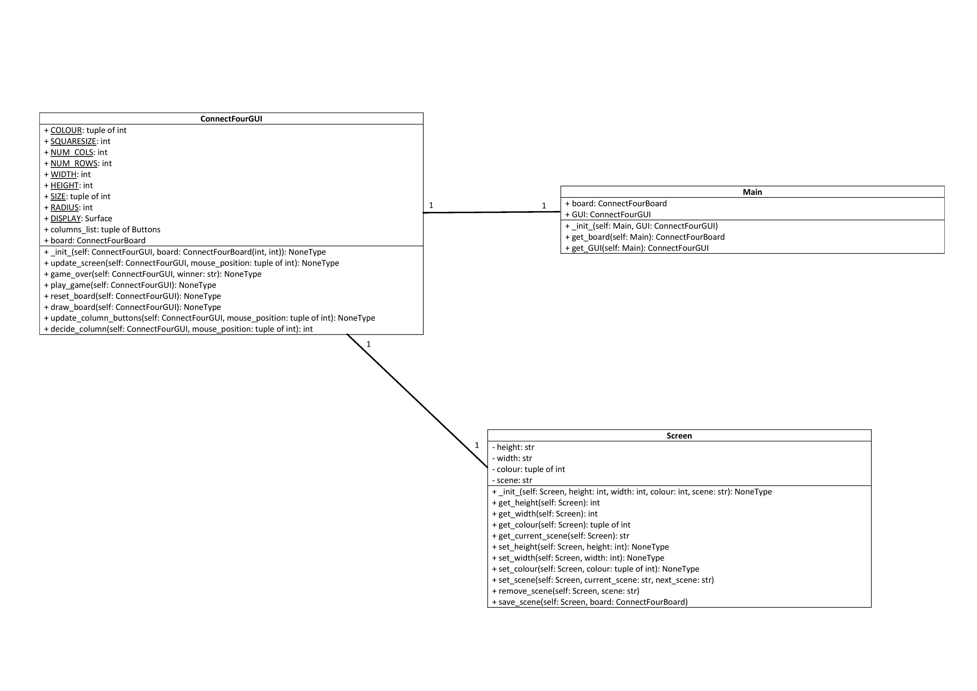
Notes:
10 seconds

Slide 15
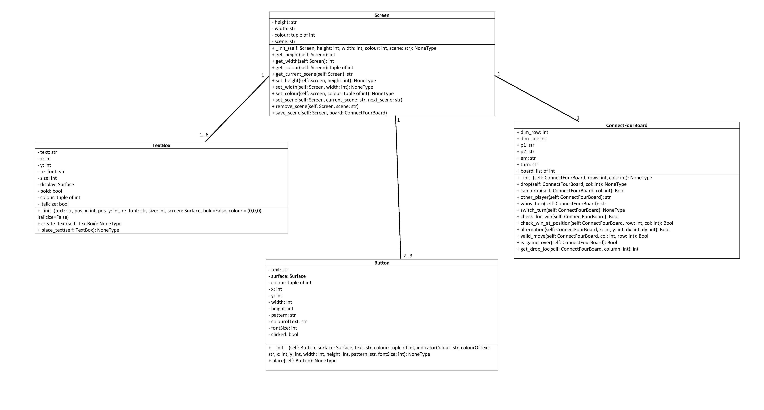
Notes:
20 seconds

Slide 16
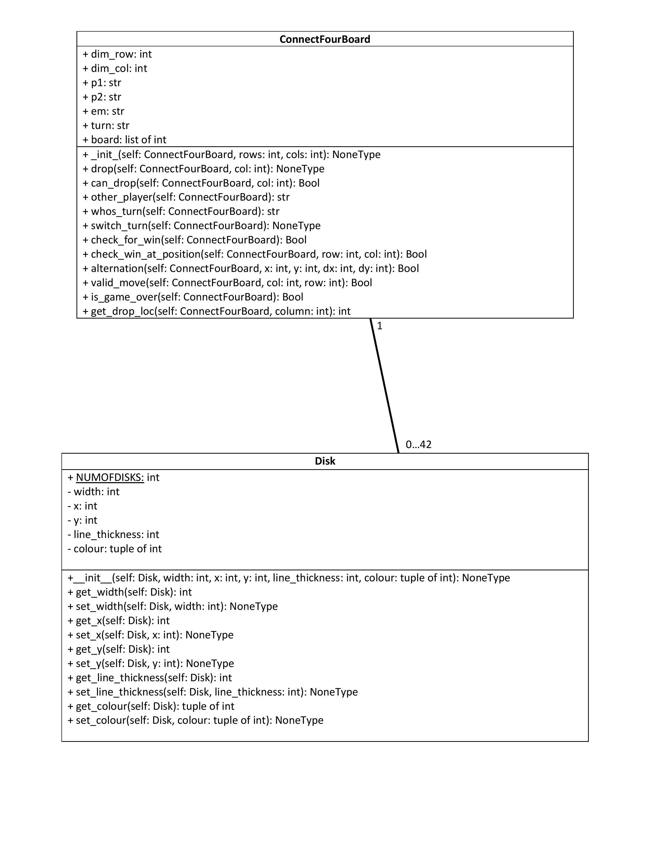
Notes:
10 seconds

Slide 17

Milestones are important.

Slide 18
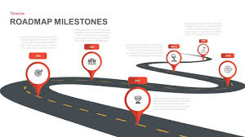
Strictly follow the milestones.

Slide 19
Communication

Slide 20
Communication is key
Notes:
14 seconds

Slide 21

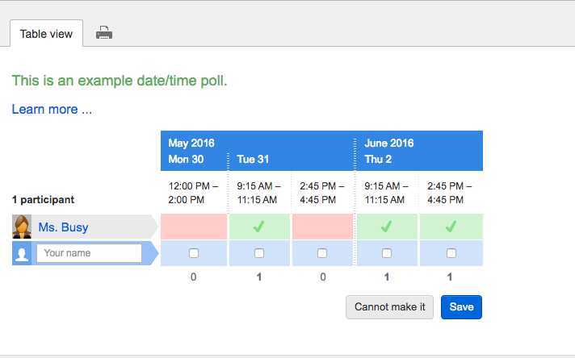

How to do better? Using tools.

Slide 22
Methods of Communication
Whatsapp – General discussion & meeting scheduling.
Github – Code reviewing and commenting on specific lines of code.
Notes:
10 seconds.

Slide 23
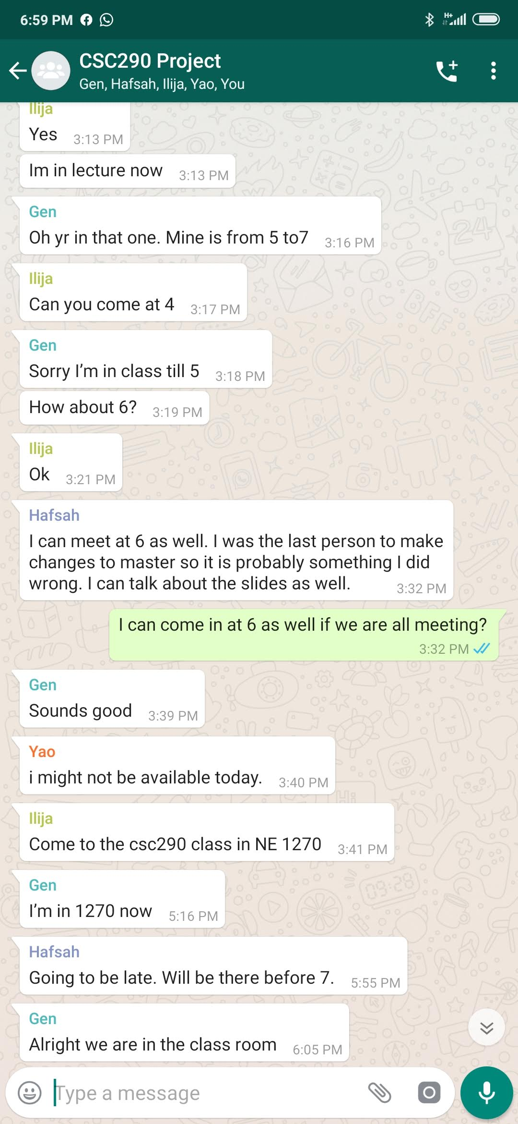
Group Message
Setting up group meetings
Trying to organize tasks and delegate items for each deadline.
Notes:
13 seconds

Slide 24
Github Pull Requests
Helps with collaboration between developers developing in the same file or working on widely used functions.
Shows the exact changes the developer made and what was changed between the commits.
Allows the reviewer to comment on each section/line of code and request changes from the developer.
Notes:
13 seconds

Slide 25
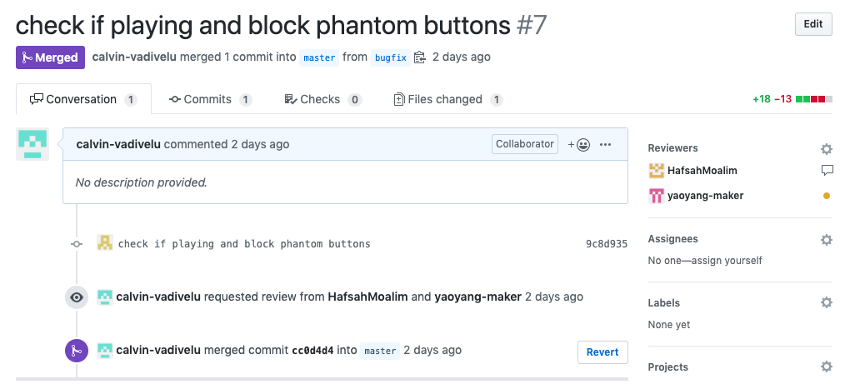
Notes:
11 seconds

Slide 26
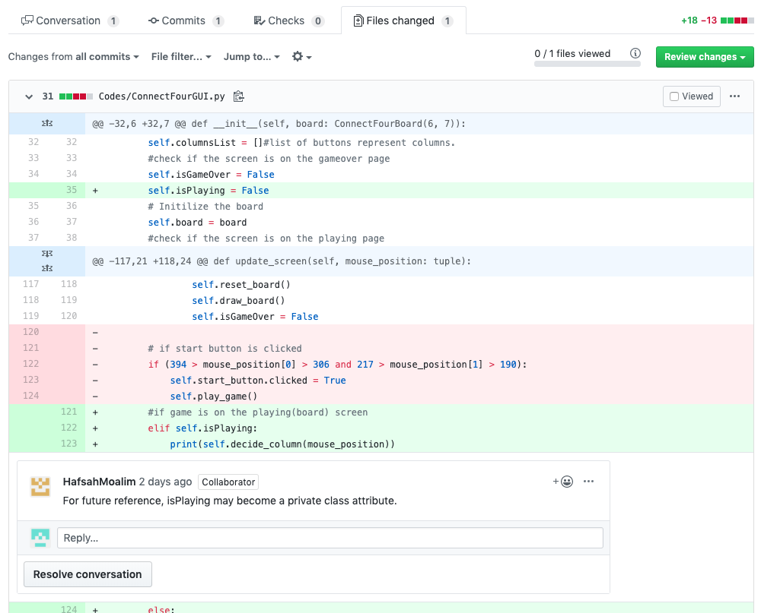
Notes:
11 seconds.

Slide 27
Face to Face Meetings are King
Everything aside, nothing is as valuable as meeting with your group face to face live to discuss progress.
Even just meeting up to code collaboratively and pushing a few features out is unmatched in terms of efficiency.
Notes:
13 seconds.

Slide 28
Installation

Slide 29



No installation required
MacOS/Linux user:
- Download ConnectFour.app
Windows user:
- Download ConnectFour.exe
No Python or Pygame needed
Download Link:
- https://github.com/NMZ0429/Connect-Four-Project/archive/master.zip

Slide 30
Game Play

Slide 31
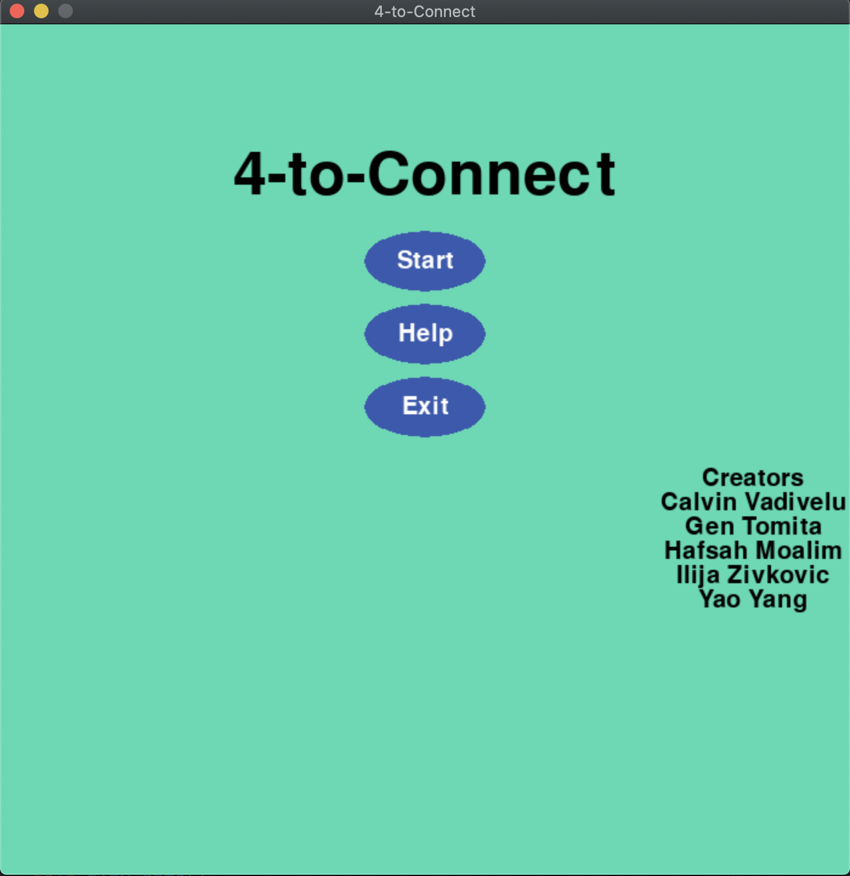
Start Menu
Three options:
Play the game
See how to play
Quit the game

Slide 32
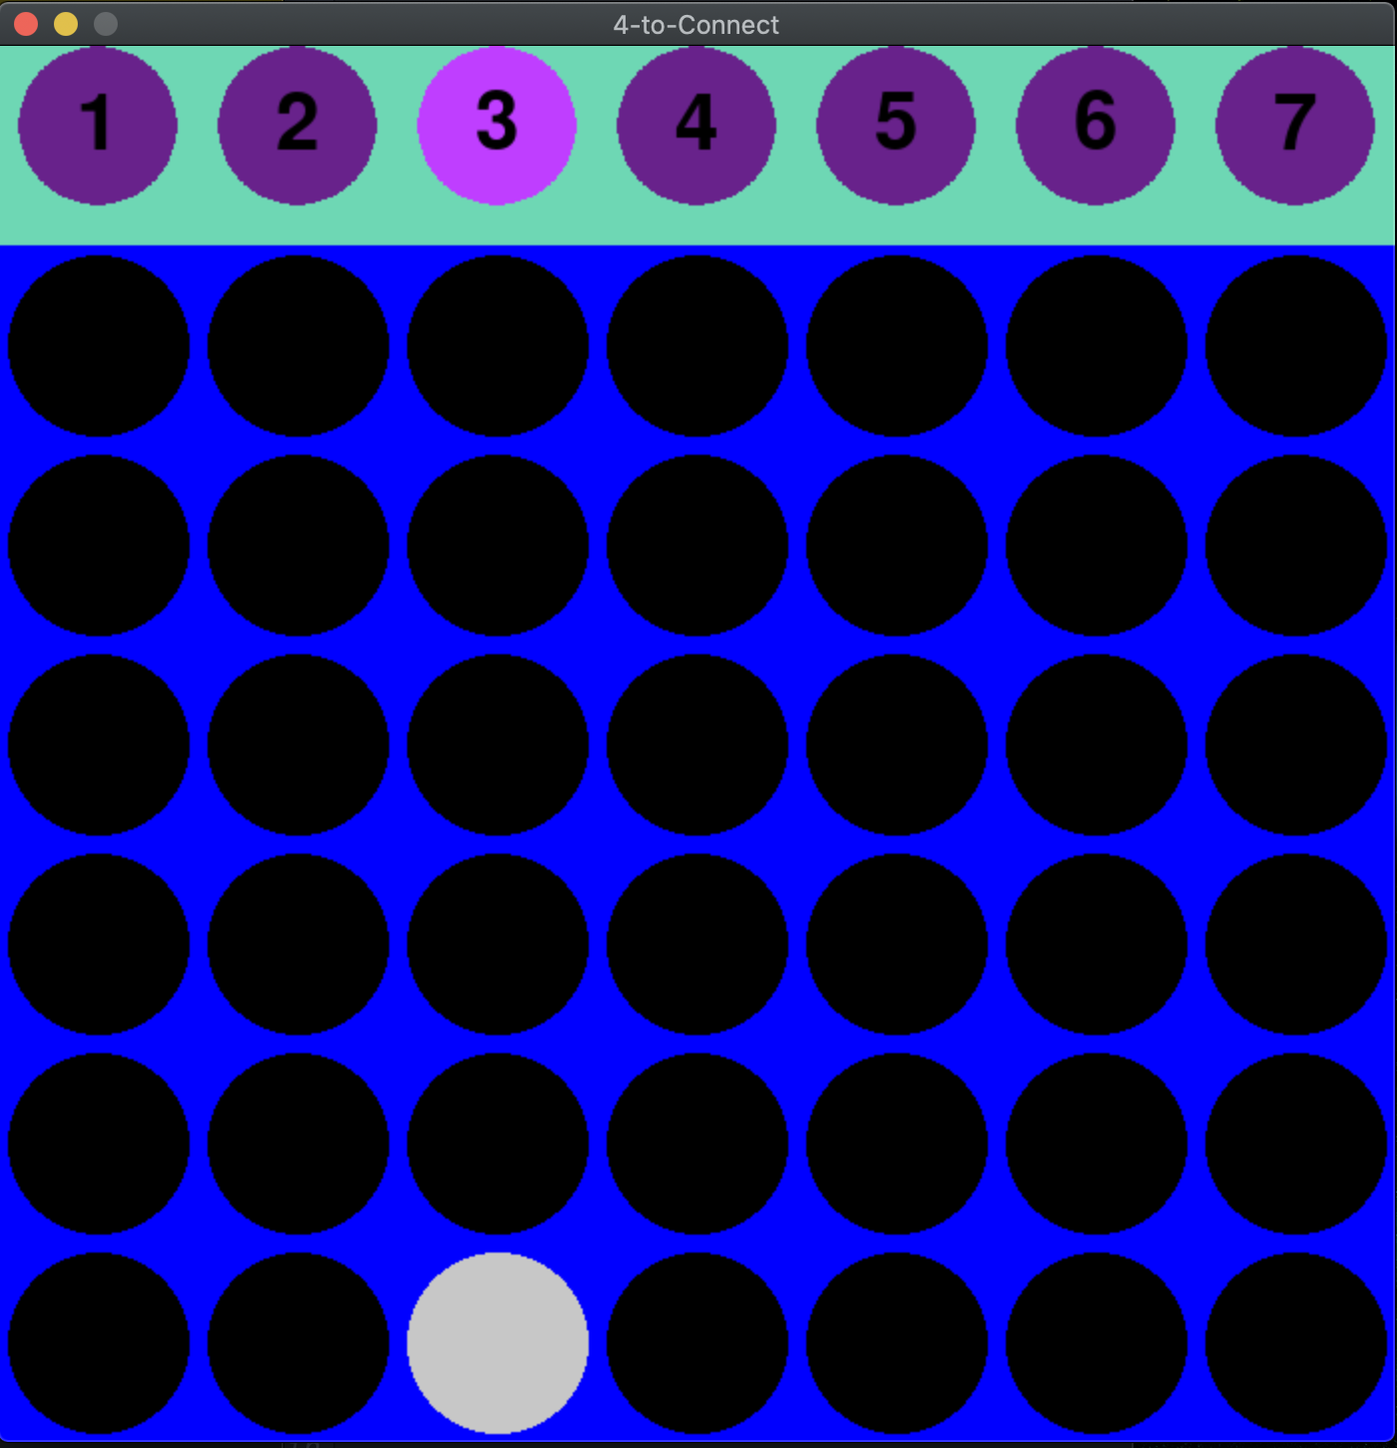
How to play
Click a column to put your stone
GUI highlight which column you are on
Any place within the column is clickable

Slide 33
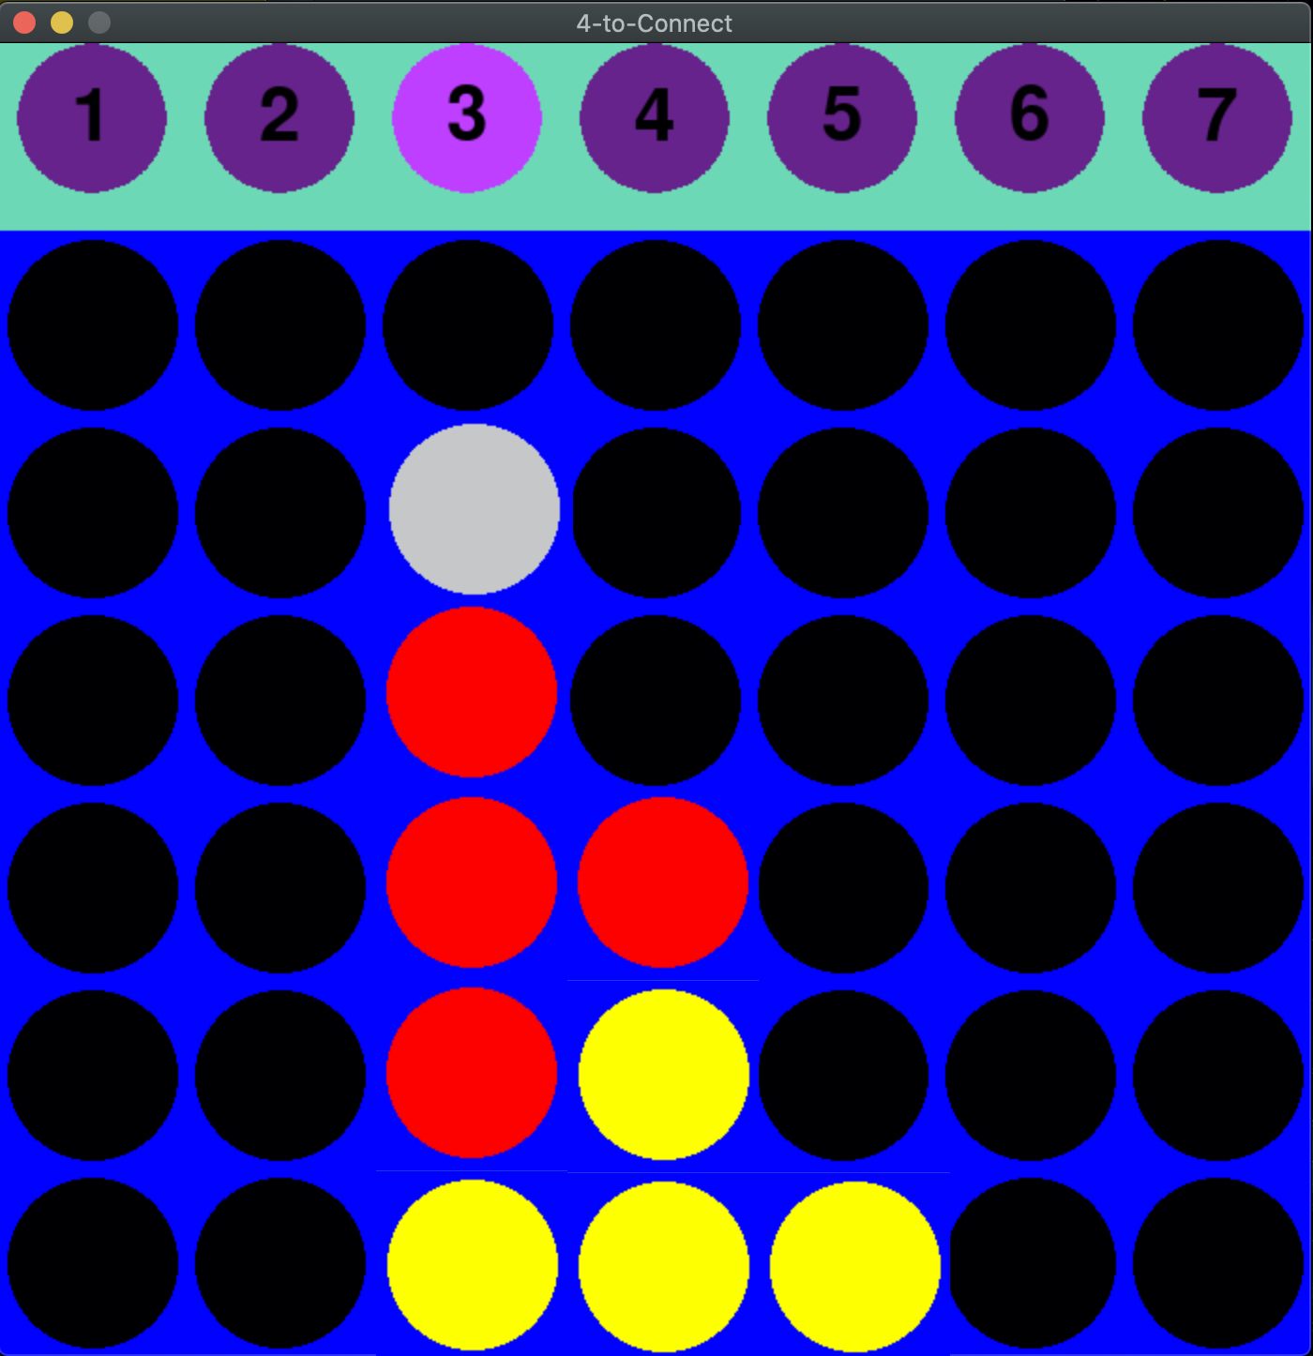
Turn change
Player’s turn is automatically switched after each click
Red stone: Player 1
Yellow stone: Player 2

Slide 34
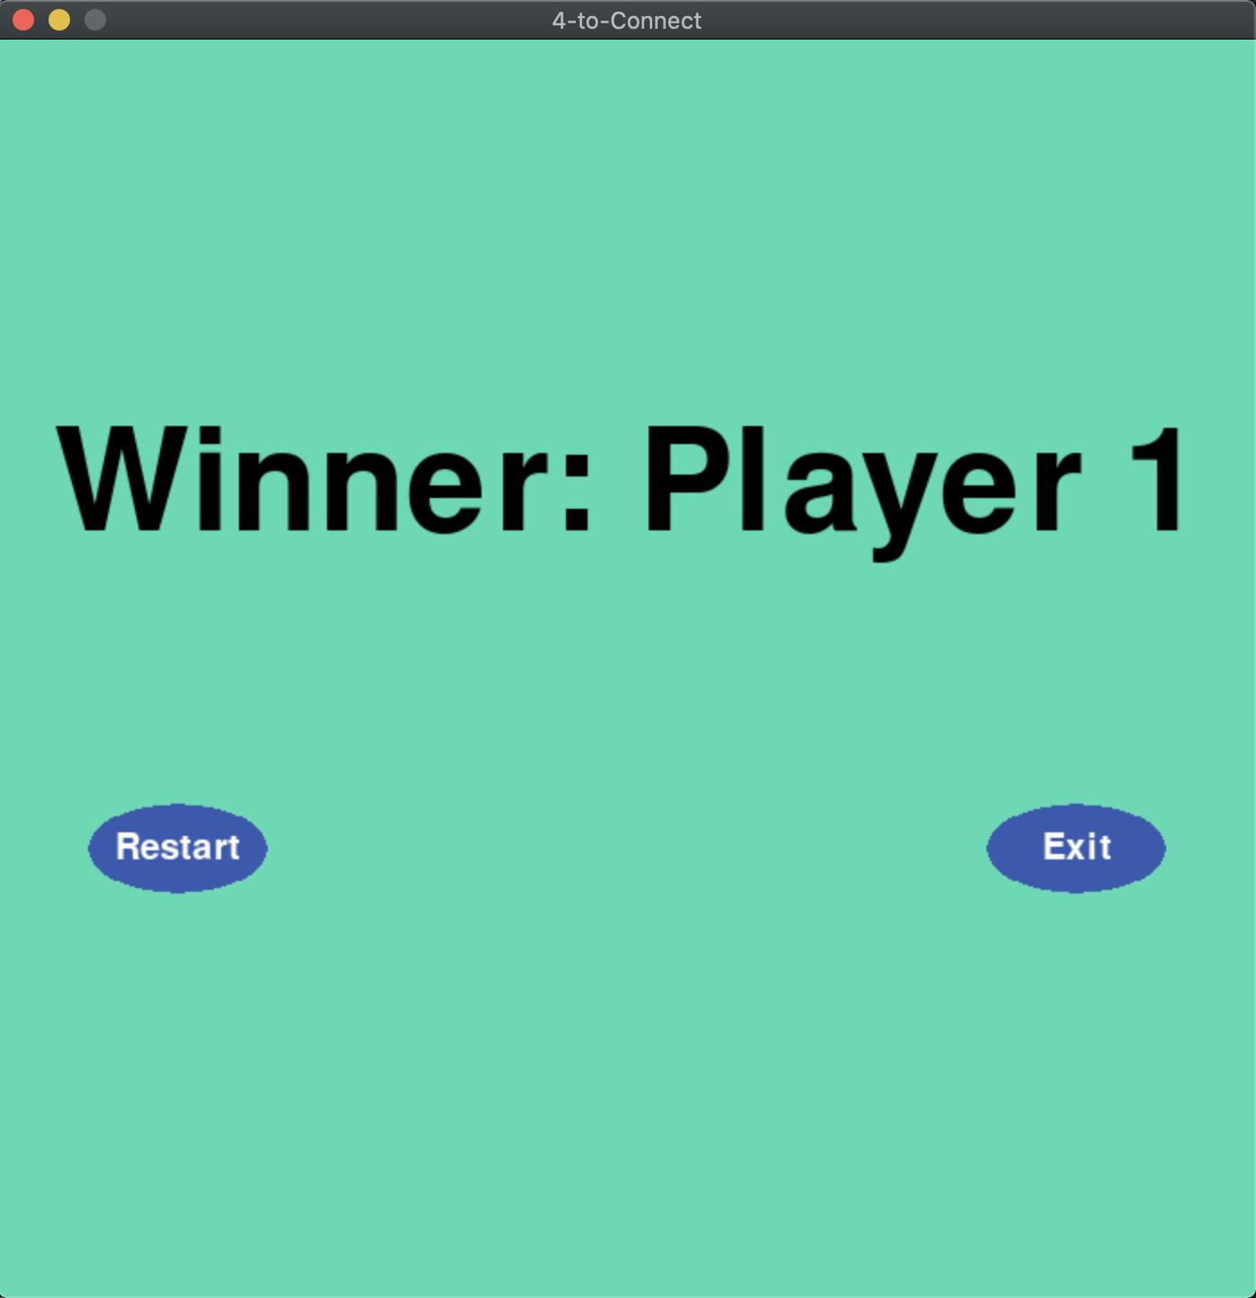
End view
Game will end when 4 stones are on a line
Then the game will show end view
You can play new match or quit

Slide 35
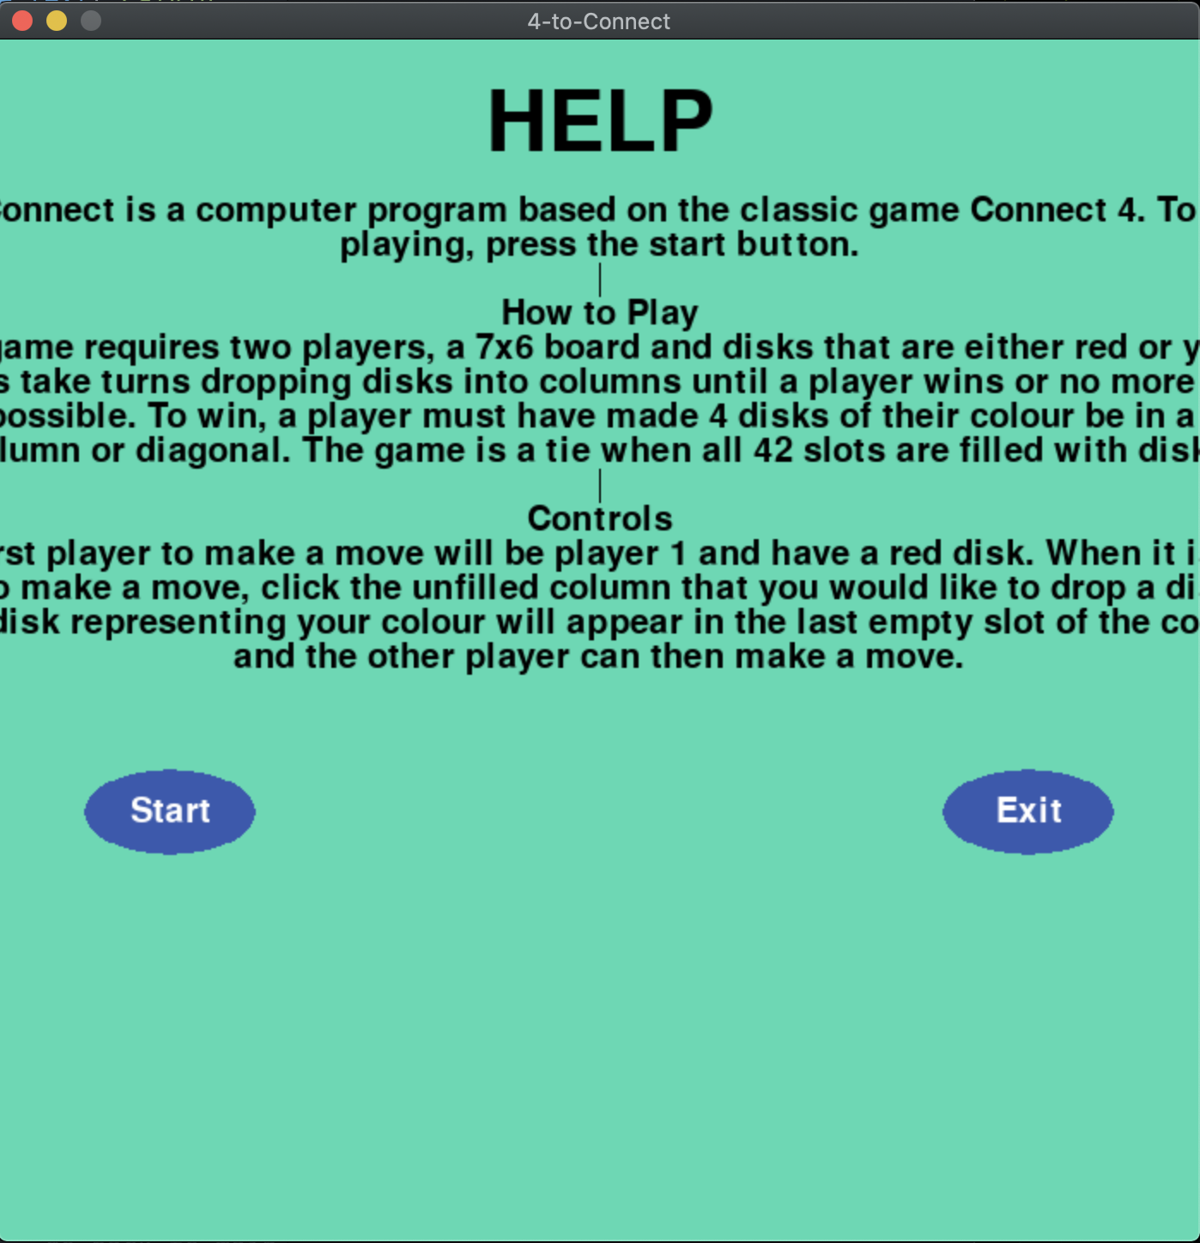
Help page
Click ”Help” in start menu
Rules and how to play

Slide 36
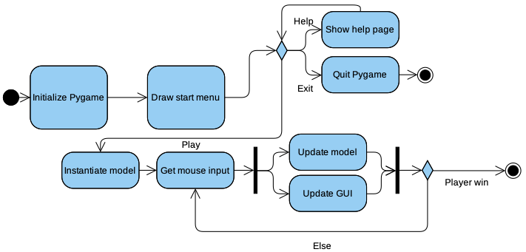
Activity diagram

Slide 37
Conclusion

Slide 38
Summary
We set out to learn game implementation with our own Connect Four using python and pygame coding
Used Agile Coding Process
Address class relationships, broke down the code organization
Learn to overcome milestones
Learn proper teamwork on communication
Game can be downloaded and played through our git hub link

Slide 39
Thank you for listening
We have been having a lot of fun collaborating and learning to try and get this thing to come together.
We would definitely love it for all of you guys to check out our game, we will keep the game’s executables up to date so you guys can keep up with our game through it’s phases and hopefully get to see it finish along with us.

Slide 40
Thank you all and we are looking forward to your feedback/questions!

